Slide 1
Project: hero factfile

Slide 2
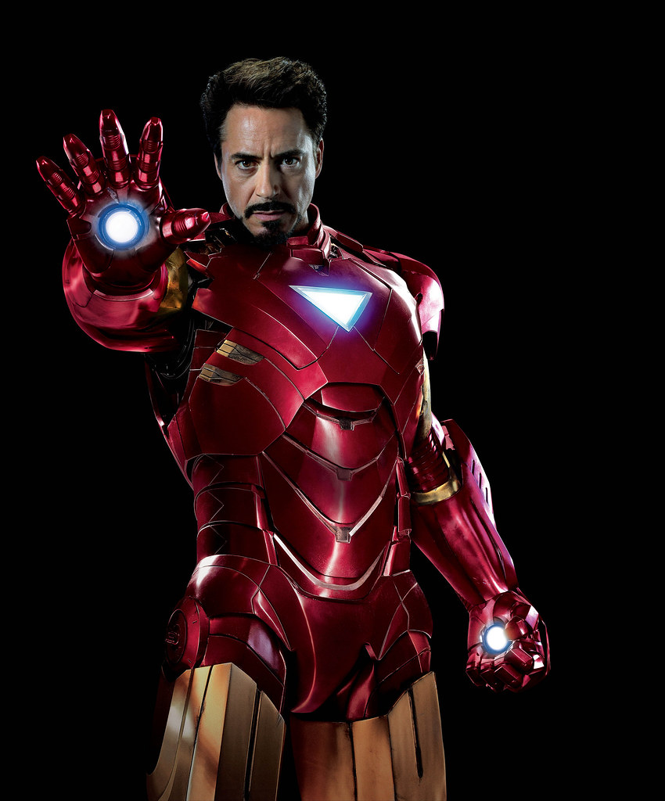
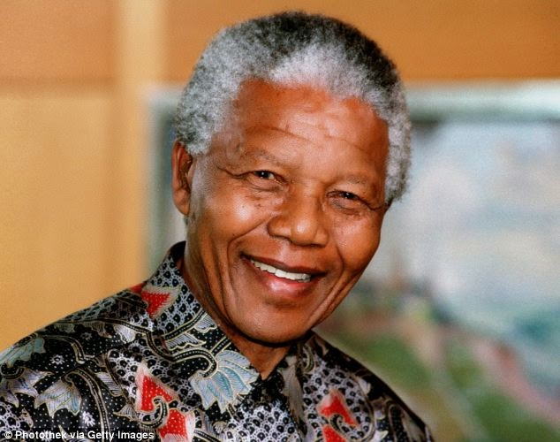
Heroes: real or FICTIONAL?
Look at the pictures.Work with your partner.
Discuss whether each person is fictional or real.
Talk about what makes each one of them a hero.
Ta fotografija korisnika Nepoznat autor: licenca CC BY-SA-NC
Ta fotografija korisnika Nepoznat autor: licenca CC BY-NC-ND
Ta fotografija korisnika Nepoznat autor: licenca CC BY

Slide 3
READ THE TEXT ABOUT ONE PARTICULAR HERO. USE THE INFORMATION IN THE TEXT TO COMPLETE THE FACTFILE. You might not have heard of Diana Prince but she is the secret identity of Wonder Woman, the DC comic superhero. Created by William Moulton Marson in 1942, Wonder Woman uses a wide range of advanced fighting skills and superhuman senses, strength and speed to battle evil-doers. Her first enemies were the military forces of Hitler and his allies in world war II, but since then she has done battle against numerous baddies, including monsters and beings from ancient legends, as well as human opponents. In terms of ability, Wonder Woman has developed such amazing senses, including telepathy, that it seems she’s almost invincible. However, she can be hurt by repeated physical attacks and by extreme temperatures. In addition to her powers, she also has some impressive gadgets and equipment, which she uses in her fight for good. The most important of these are her lasso of truth, which she uses to force her enemy to give honest answers, and her bracelets and tiara, which act as bulletproof shields and a deadly weapon. Wonder Woman doesn’t have a sidekick to help her, but she has occasionally been part of the superhero team known as the Justice League (together with characters such as Superman, Batman and Green Lantern). You might ask how she came into being? Well, like most heroes, wonder woman has a great backstory. She’s not actually human but rather one of an immortal race known as the Amazons, who were created by Greek goddesses from the souls of women who had been murdered by men. Her Amazon name is Princess Diana of Themyscira (also known as Paradise Island). Her secret identity as Diana Prince was something she bought from a real military nurse who was trying to find a way to leave the us army. Wonder Woman entered our world as a kind of ambassador from her nation when she was required to bring back to civilization an army pilot who had crashed on Paradise Island. Around this time, her mother, the queen of the Amazons, told her she must fight for justice. To begin with, she finds modern western culture very confusing and comes across as naïve, but soon it becomes clear that she has a strong, if simple, character and will persevere in trying to help humankind even if she doesn’t understand our actions.

Slide 4
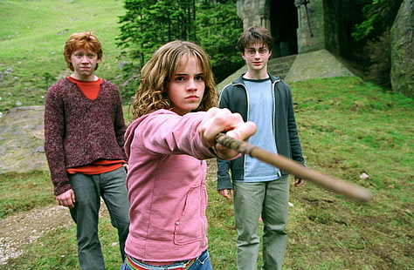
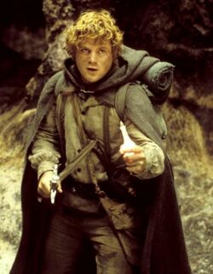
procedure
STEP 1: work in pairs – read the text and complete the factfile
STEP 3: prepare a factfile like the one on Wonder Woman and then write a biography of your hero. You may draw your hero as well.
STEP 2: choose one of the heroes in the box and use the Internet to find out more information about the hero.
HERMIONE GRANGER, THALIA GRACE,PETER PARKER, BRUCE WAYNE, HAN SOLO, KATNISS EVERDEEN, TONY STARK, ATTICUS FINCH, SAMWISE GAMGEE
Ta fotografija korisnika Nepoznat autor: licenca CC BY-SA

Slide 5
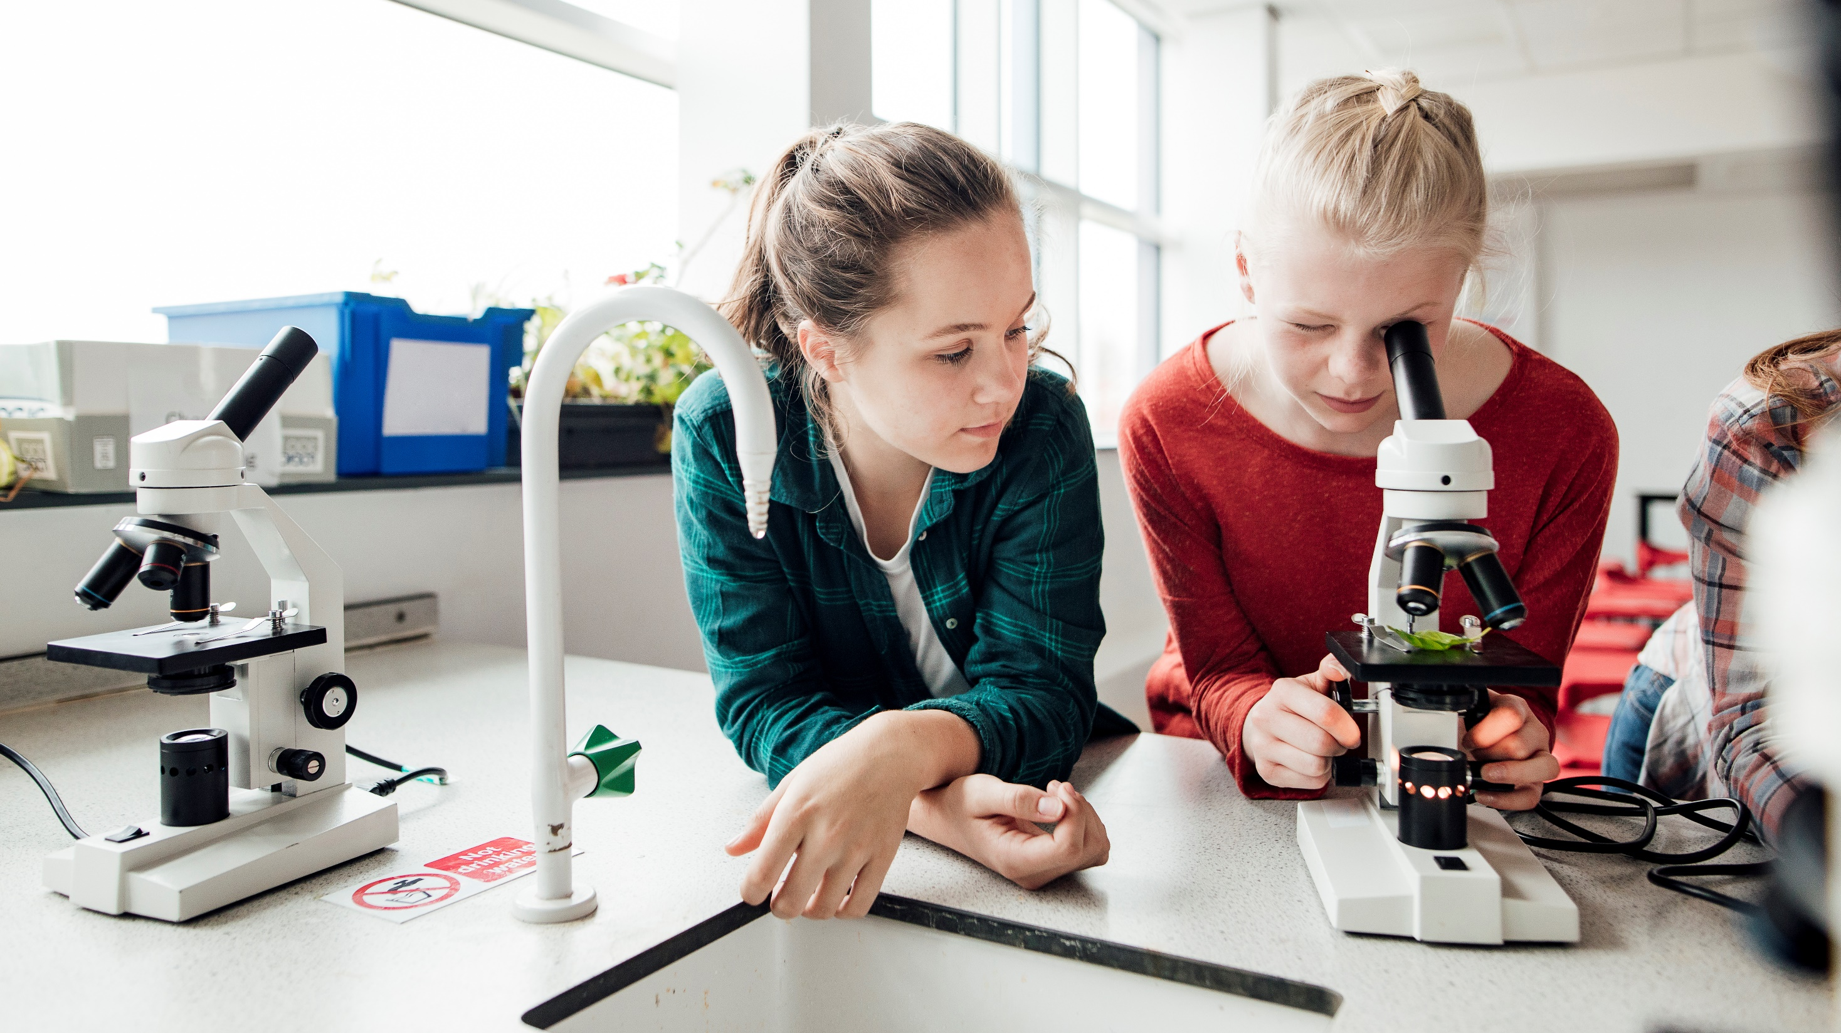
Thank You

